Slide 1
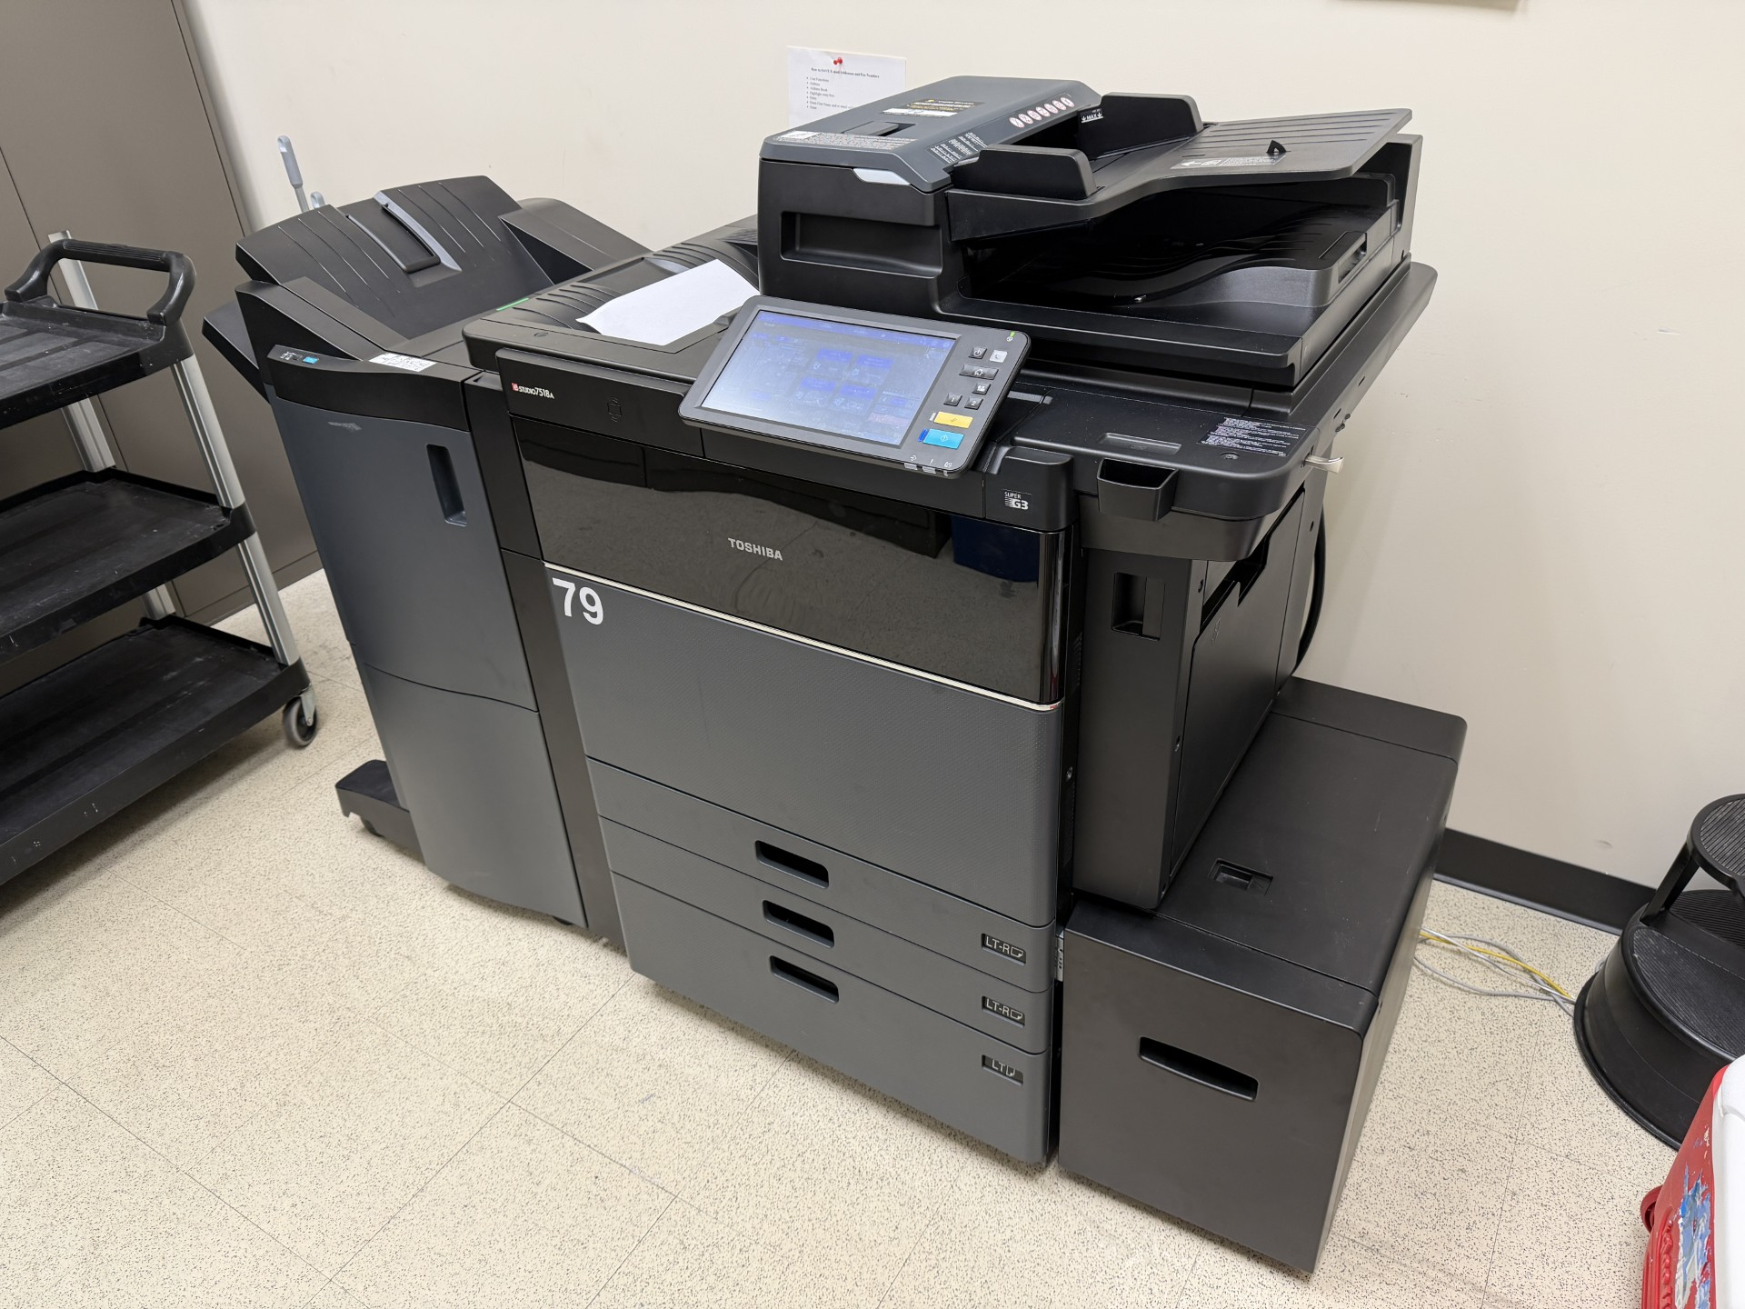
COPY “The ULTIMATE” Contact Manager
Team #1
Processes for Object Oriented Software Development (COP 4331C) – Spring 2026 – Section 3 with Dr. Aashish Yadavally

Slide 2

What is COPY?
COPY stands for "The Contact Organizer for POOSD with Yadavally." COPY is the website built by Team 1 for the Small Project assignment required by the Processes of Object-Oriented Software Development (aka "POOSD" or COP 4331C) at the University of Central Florida (UCF) in Orlando, FL.
Our section of the course (section 3) is being taught by Dr. Aashish Yadavally during the Spring 2026 semester. This website implements the LAMP tech stack (Linux, Apache, MySQL, and PHP) and is hosted on a DigitalOcean virtual server with a domain purchased from GoDaddy.com. COPY was designed to be an easy way to manage your own personal contact list. COPY supports the following features:
Adding new contacts
Deleting existing contacts
Editing existing contacts
Searching through contacts (including partial matching)
The website is at https://copycm.com and you can find the GitHub Repository at https://github.com/ABetinsky/cop4331-sm-project

Slide 3
About The Team

Slide 4
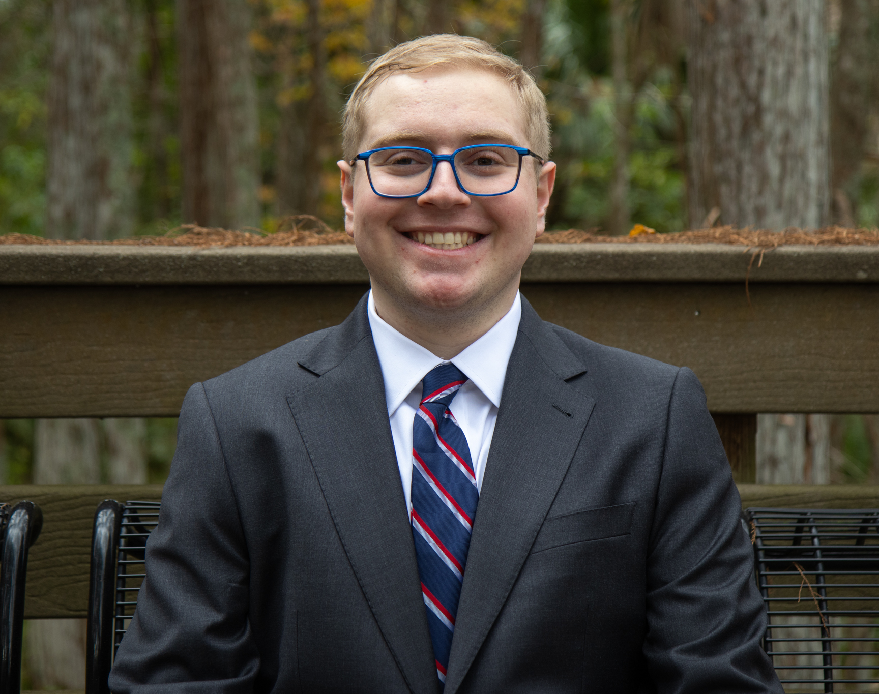
Adam Betinsky Project Manager & Frontend Developer
Adam’s Contributions to COPY Include:
Organizing weekly team meetings and a Discord Server for communication
Providing an initial idea of what the Frontend could look like
Tidying the Frontend for any issues with formatting, colors, images, etc
Organizing the GitHub Repository
Constructing the Gantt Chart, Lighthouse Reports, and Most of The Final Presentation

Slide 5

Benjamin Quintero Frontend Developer
Benjamin’s Contributions to COPY Include:
Creating and styling almost all the About Us Page
Ensuring consistency in styling between web pages
Fixing certain browser compatibility issues in code, such as lack of support in safari-based browsers and issues with changes based on browser resolution

Slide 6
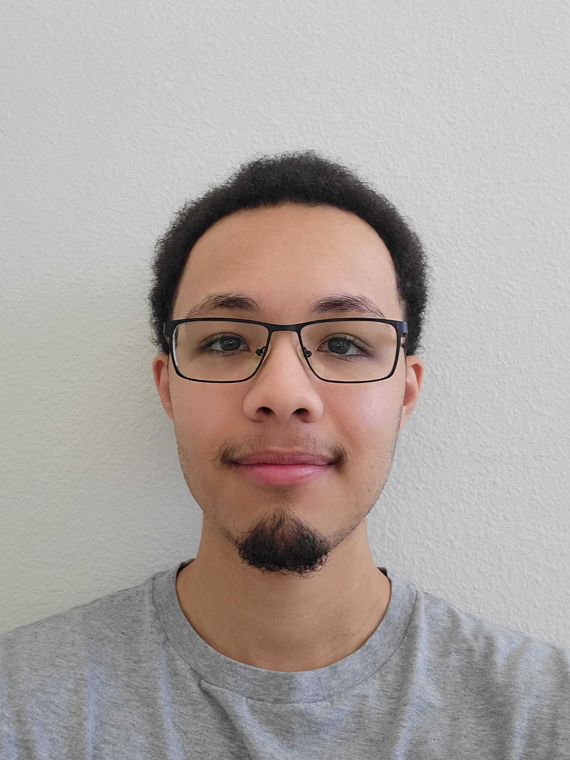
Andrew Reyes API Developer
Andrew’s Contributions to COPY Include:
Designing and implementing API endpoints for contact management, which include contact addition, modification, removal, and retrieval
Drafting the SwaggerHub API documentation
Configuring automatic deployment to our remote server
Adding small visual enhancements to the signup and contacts pages

Slide 7
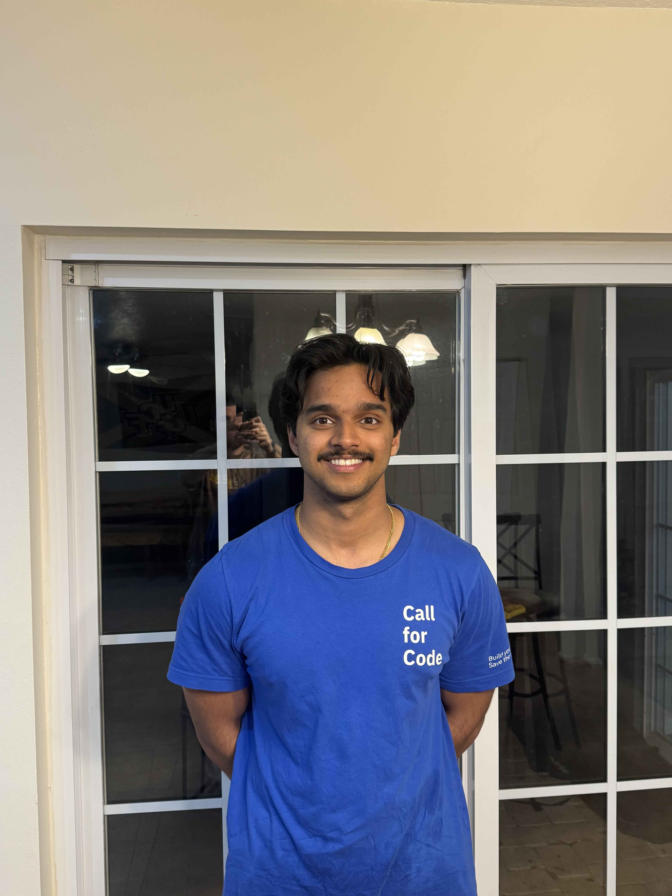
Noah Gerard API Developer
Noah’s Contributions to COPY include:
Creating sign-up and login functionality
Creating database connection utilities
Implementing cookie-based user session authentication
Connecting initial frontend to backend for login/signup functionality

Slide 8
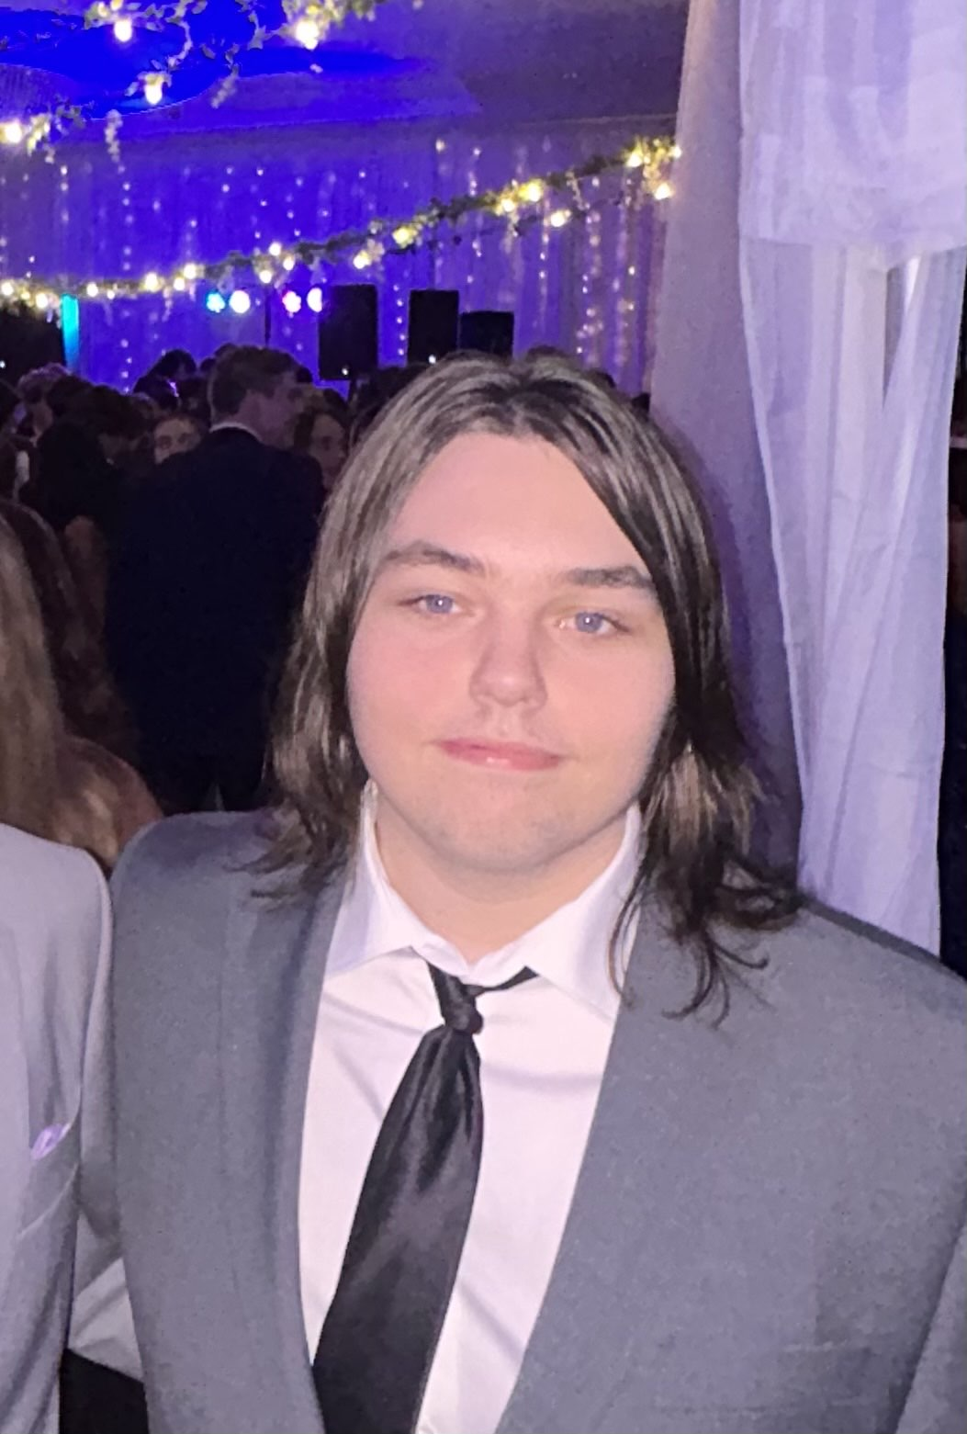
Darren Squires Database (Backend) & Frontend Developer
Darren’s Contributions to COPY Include:
Modifying database schema
Making the Contacts Page (front-end)
Implementing partial-searching for the contacts page
Enhancing Contacts Page API
Initially drafting the README.md, Use-Case Diagram and Entity Relationship Diagram (ERD)

Slide 9
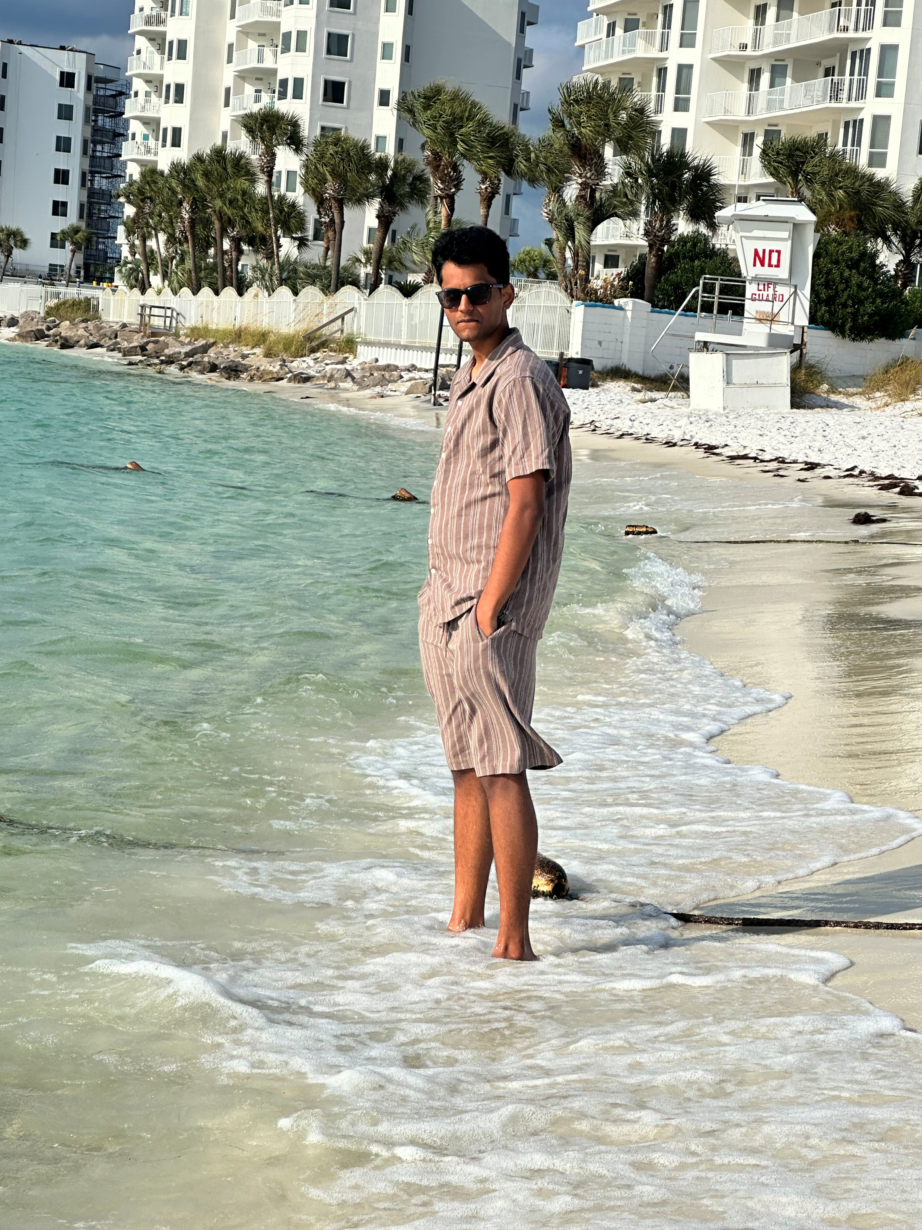
Pranav Cheruku Database (Backend) & Frontend Developer
Pranav’s Contributions to COPY Include:
Initially setting up the database in the Virtual Private Server (VPS)
Coding the database to match the specifications of the project (I.E. storing each contact’s attributes, determining how to link it to the API, etc)
Adding visual features to the Frontend such as: The Clock, Real-Time Error and Success Messages, and Interactive Page Navigation Buttons

Slide 10
How Did We Make COPY?

Slide 11
Communication Methods

Slide 12
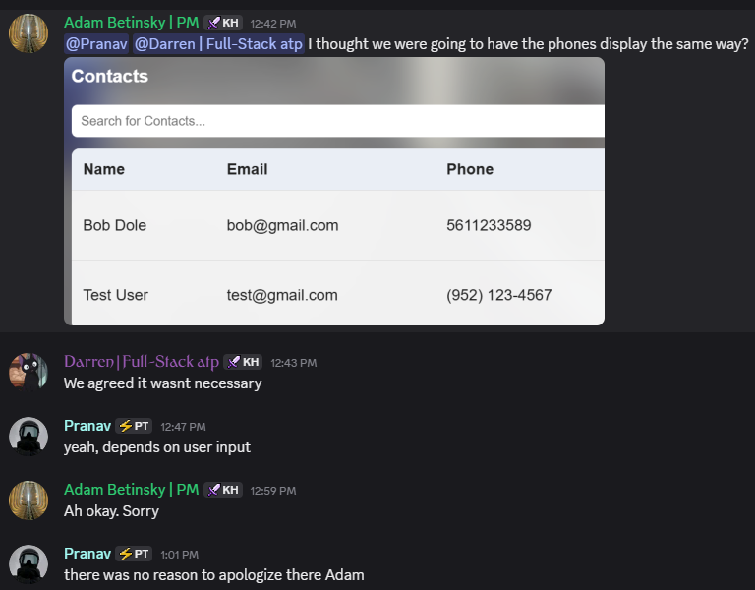

Primary Communication Discord
Our Primary Method of Communication:
Usually via text-based messages
Everyone communicated at least 2 times a day in the server. It was almost always a lot more
We asked each other questions about implementation, concerns about code, feedback on ideas, and more
We were able to get responses quickly, and message a specific member directly if needed

Slide 13

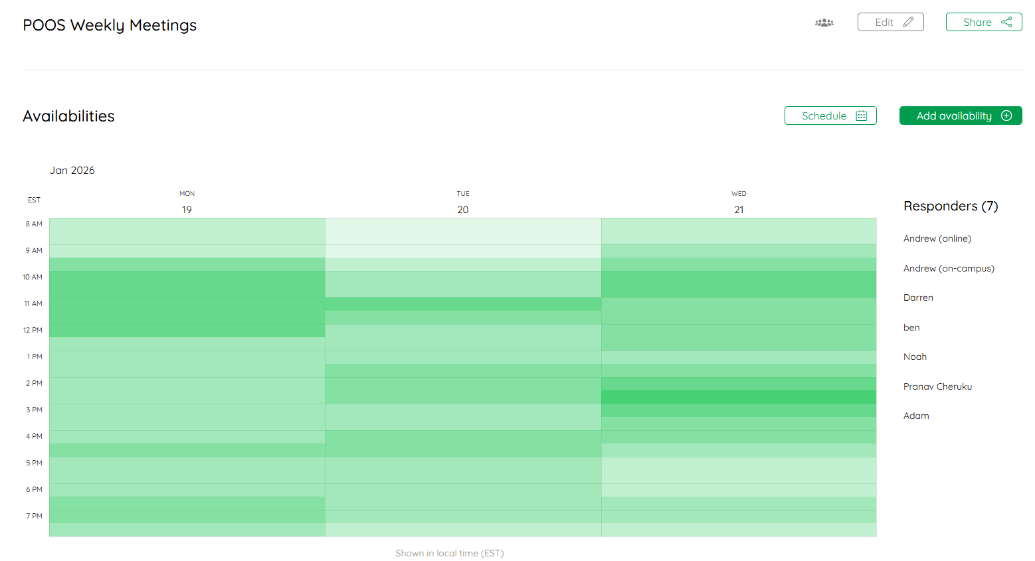
Meeting Planning LettuceMeet
We Used LettuceMeet to Plan Our Regularly Scheduled Meetings:
We wanted to meet once per-week (virtually), on Monday, Tuesday, or Wednesday (so we could fix something on Thursday for Class on Friday if needed)
LettuceMeet allowed each tam member to enter their own availability
We were able to quickly and visually identify a team that worked best for all of us

Slide 14

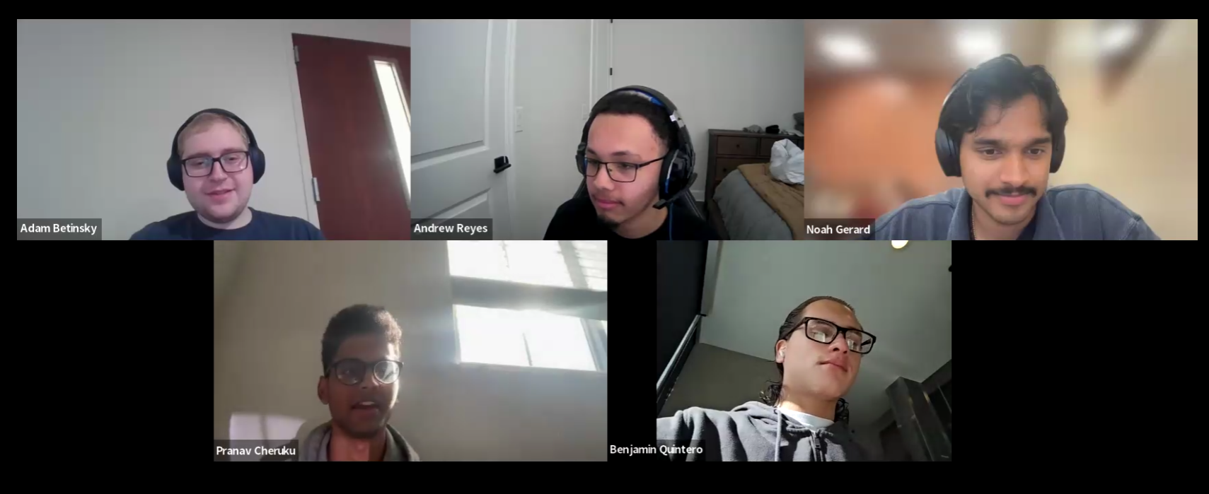
Virtual Meetings Zoom
We used Zoom to host our virtual weekly meetings (4 of them) on Wednesday’s from 2:30 PM – 3:00 PM :
We were able to easily update each other on progress we made, with examples and clarity (see next slide)
We were able to record each meeting should we need to review something again
It allowed to get everyone together with ease – no need to book a meeting room somewhere on campus

Slide 15
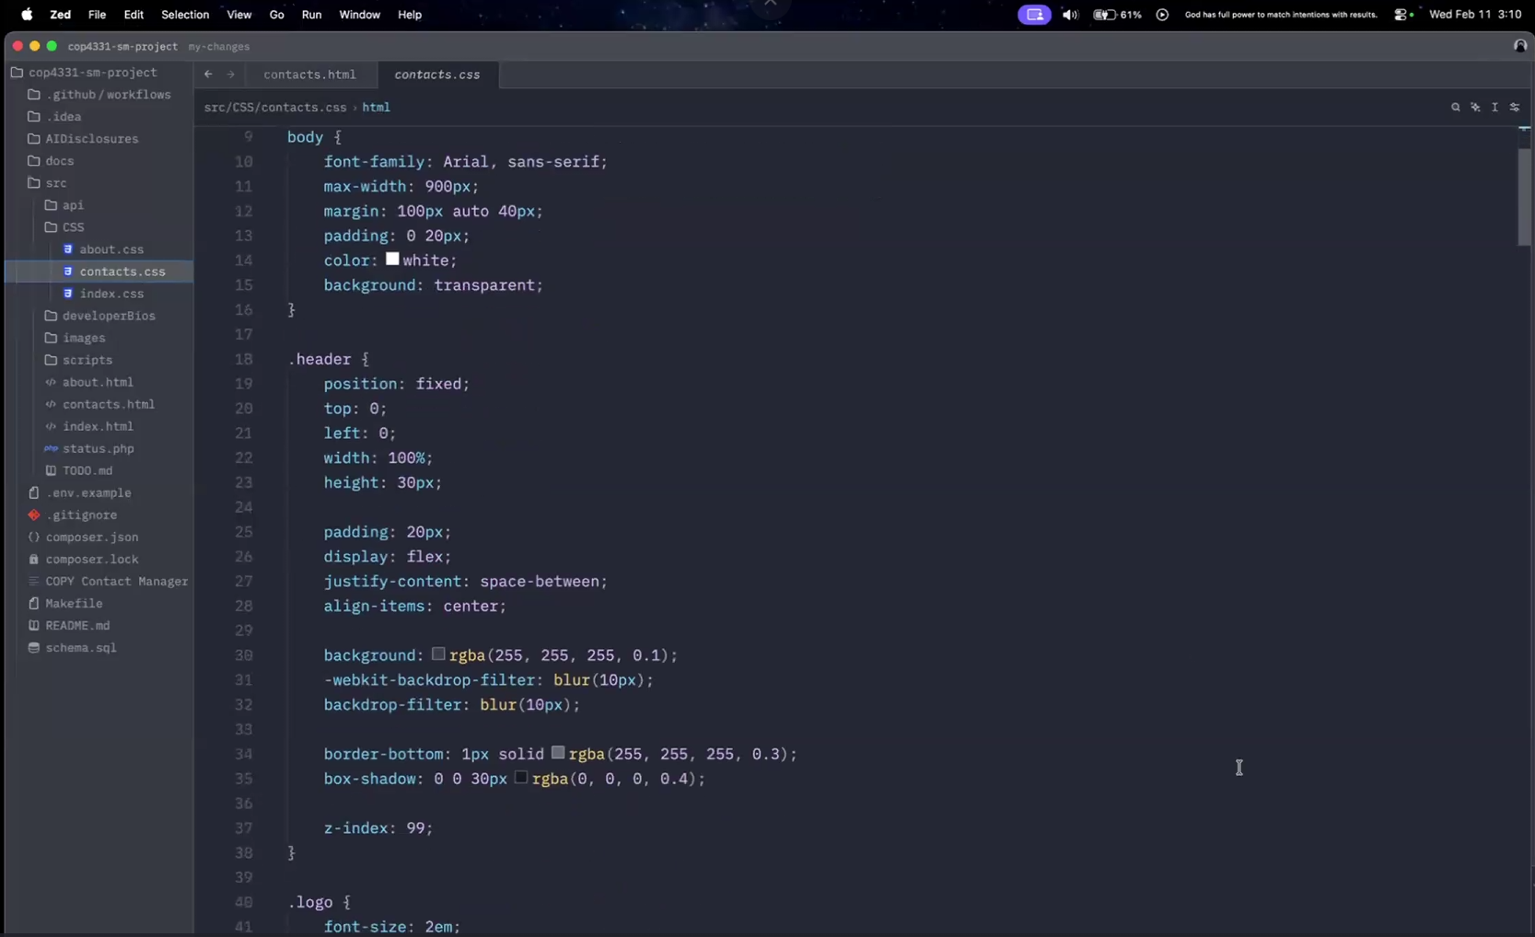
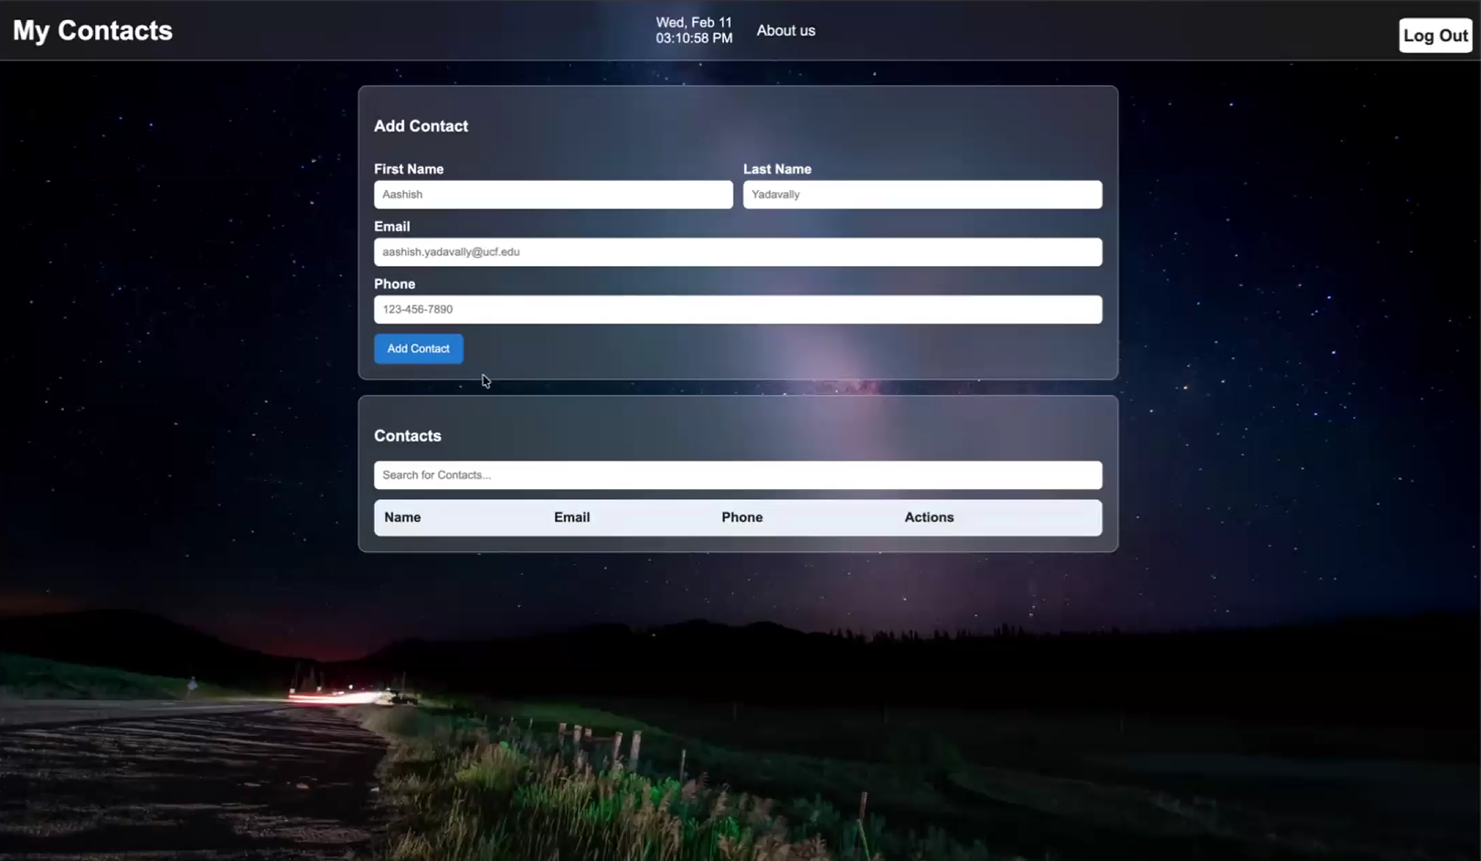
We could easily see how each other’s code was progressing during each meeting towards each portion of the website.

Slide 16
Non-Communication Technologies

Slide 17


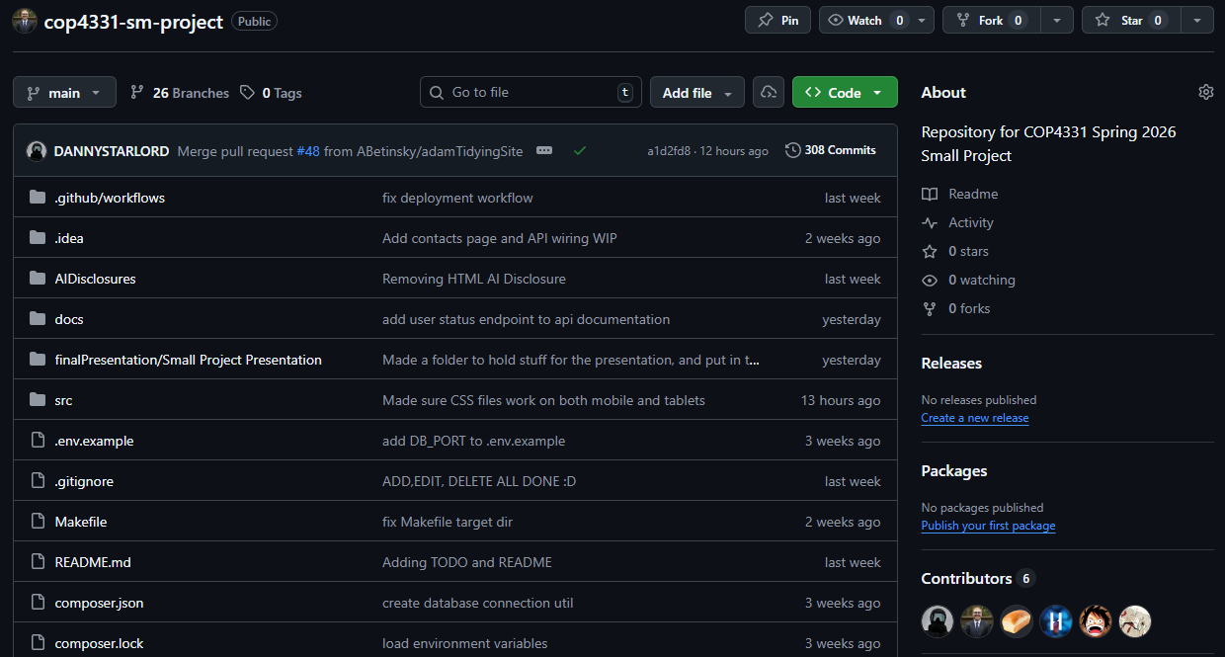
Version Control Git & GitHub
We used a Git repository to easily keep track of any changes to our code. We were able to clone the repository on each other’s devices using GitHub. GitHub also provided us real feedback to any conflicts, issues, or other concerns. Both platforms allowed for us to collaboratively see each other’s changes and easily identify if each member was doing their own part. Plus, we setup a listener on our VPS so that whenever we pushed to our Git repository, it would automatically sync on our VPS as well.
The next slide has an example of how we used Pull Requests to ensure a new feature was accurate before fully implementing a change.

Slide 18
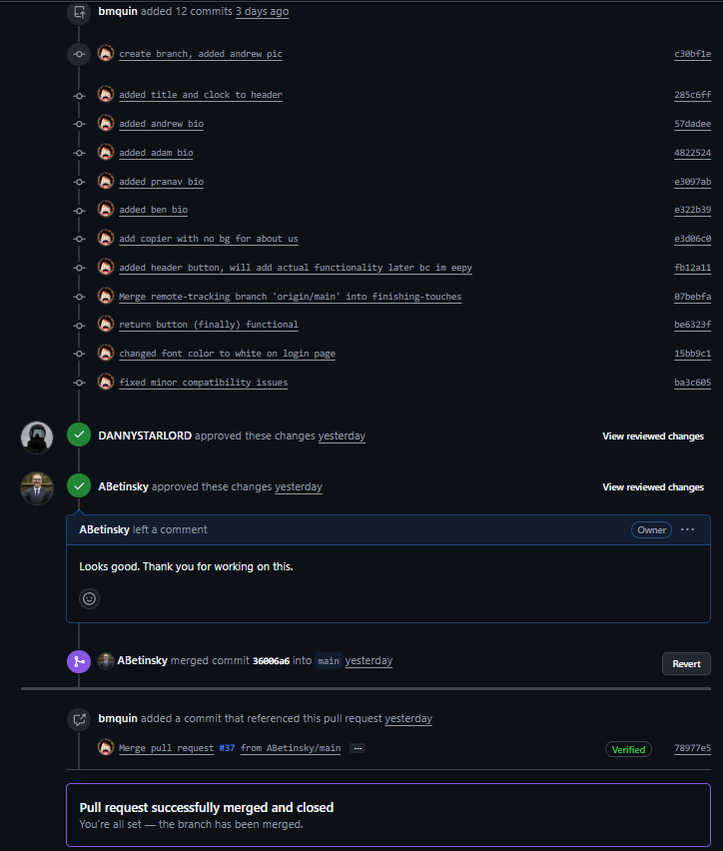
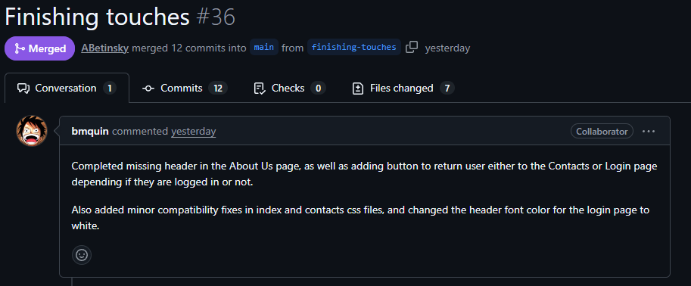
Pull Request Example

Slide 19
Frameworks, Database and Other Technologies
I need someone else to fill this in plz – Adam
Please be sure to mention LAMP

Slide 20

Artificial Intelligence (AI) Usage
AI is becoming mainstream in the technology sector, and we wanted to use it as a tool. For the project, we used AI as follows:
When we decided to use AI, we mainly used ChatGPT 5.2 by OpenAI, as it’s one of the most common platforms for AI.
We primarily used AI to tutor us on things that were unfamiliar as we could receive near-instant feedback. For example, Adam used it to understand how to properly create and push to a branch on Git without overriding any other code.
We worked extremely hard to not use any code generated by AI, as not only could it be incorrect, but it would make it more challenging for us to learn the new programming languages on this website.
With that said, however, there were about 5 times we did use small segments of code generated by AI. When we did, we ensured to fill out an AI disclosure and promptly review all code for accuracy.

Slide 21
Progression Timeline

Slide 22
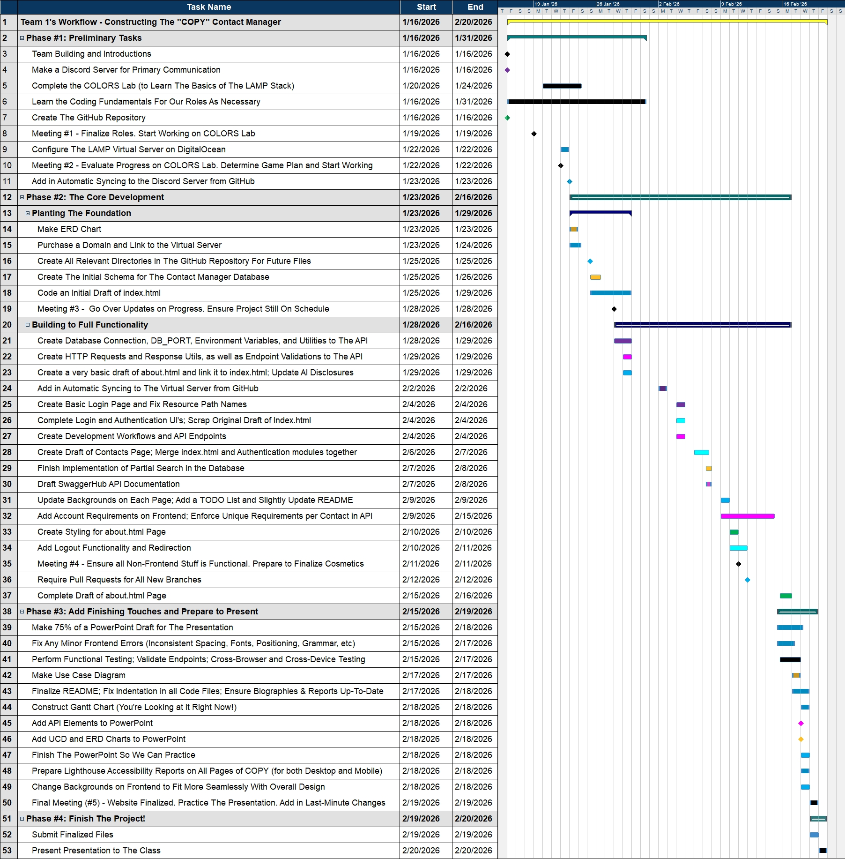

Gantt Chart MindView
To visually see our actual timeline on the project, we created a Gantt Chart. (We also created it since it’s required ☺). The Gantt Chart was created using MindView, a software that creates various different charts, including Gantt Charts.
Although our complete Gantt Chart is on this slide, we will go through each portion (and show the relevant charts) on the next few slides.

Slide 23
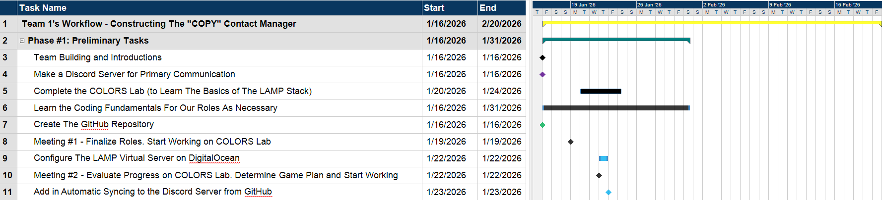
Gantt Chart - Phase #1: Preliminary Tasks
Color Key for Gantt Chart – Phase #1: Preliminary Tasks
Yellow = Overall Project Timeline
Turquoise = A Main Phase Timeline
Black = A Task Completed by Everyone
Purple = A Task Completed by Noah
Green = A Task Completed by Benjamin
Blue = A Task Completed by Adam

Slide 24
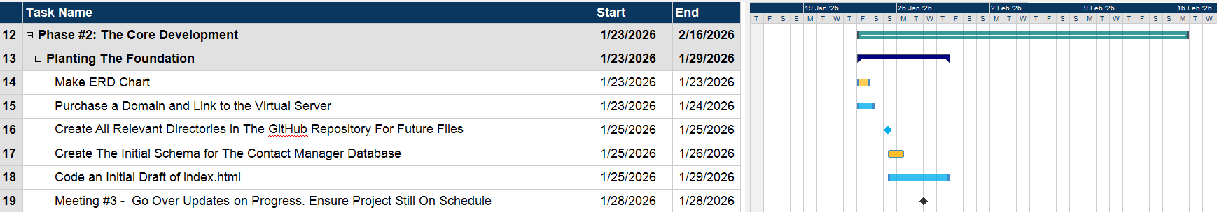
Gantt Chart - Phase #2: The Core Development Part #1: Planting The Foundation
Color Key for Gantt Chart – Phase #2: The Core Development, Part #1: Planting The Foundation
Turquoise = A Main-Phase Timeline
Navy Blue = A Sub-Phase Timeline
Orange = A Task Completed by Darren
Blue = A Task Completed by Adam
Green = A Task Completed by Benjamin
Black = A Task Completed by Everyone

Slide 25
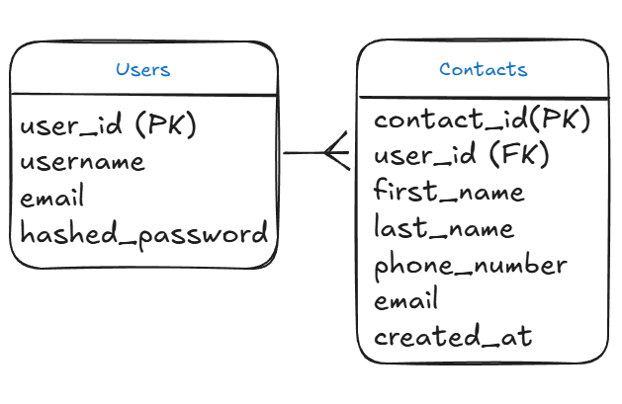
ERD Chart
The database is structured around two core entities: Users and Contacts.
A one-to-many relationship is used because one user can have many contacts, but each contact belongs to exactly one user.
The user_id in the Contacts table is a foreign key that enforces data ownership and prevents cross-user access.
Separate tables were used to maintain data isolation, security, and normalization.
Passwords are stored as hashed_password to follow basic security best practices.
The structure supports all CRUD operations efficiently while keeping the schema simple and scalable.

Slide 26
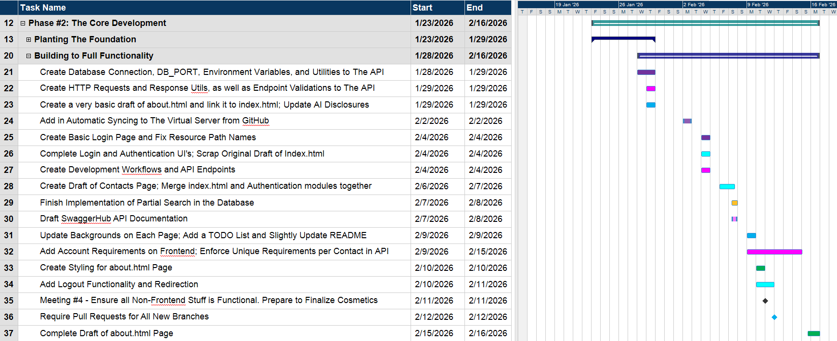
Gantt Chart - Phase #2: The Core Development Part #2: Building to Full Functionality
Color Key for Gantt Chart – Phase #2: The Core Development, Part #2: Building to Full Functionality
Turquoise = A Main-Phase Timeline
Navy Blue = A Sub-Phase Timeline
Purple = A Task Completed by Noah
Pink = A Task Completed by Andrew
Ice Blue = A Task Completed by Pranav
Orange = A Task Completed by Darren
Blue = A Task Completed by Adam
Black = A Task Completed by Everyone

Slide 27
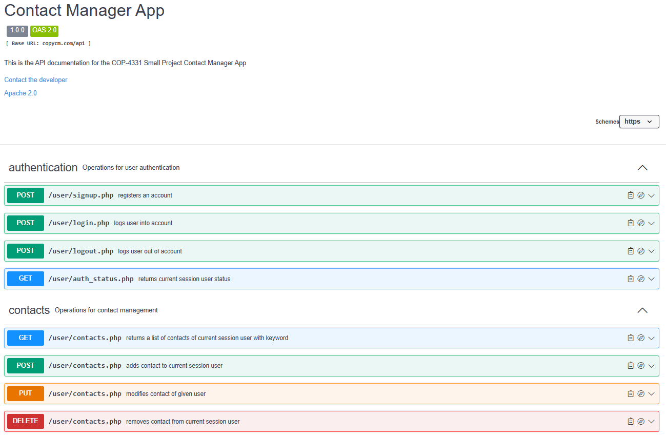
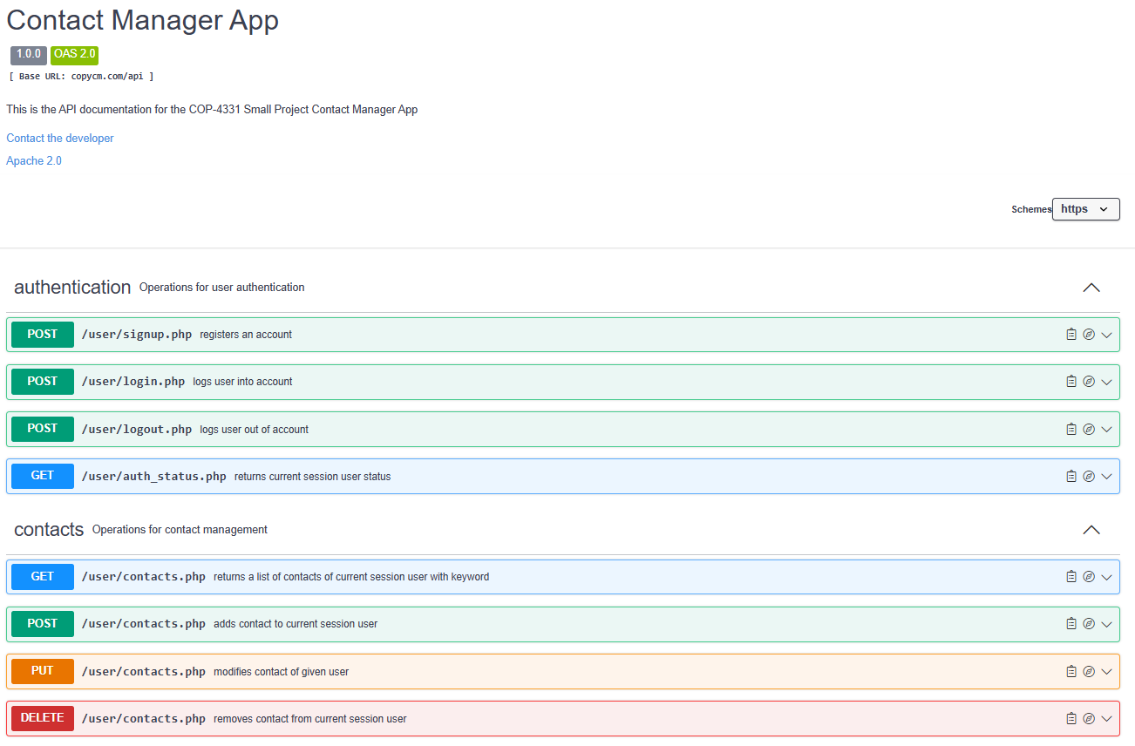
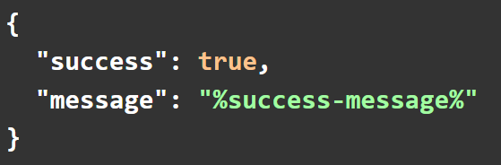
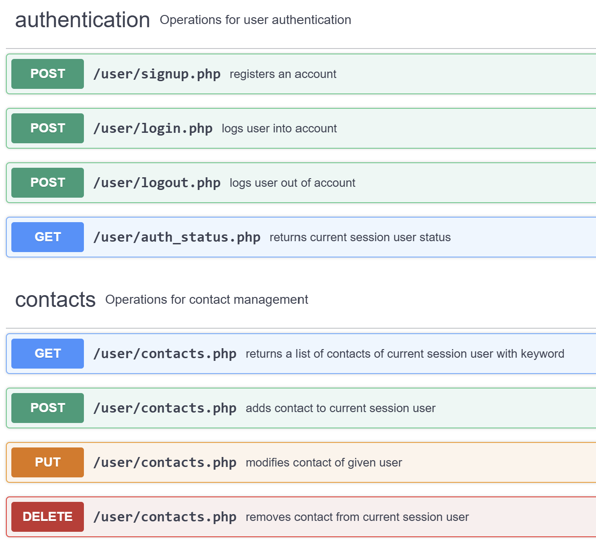
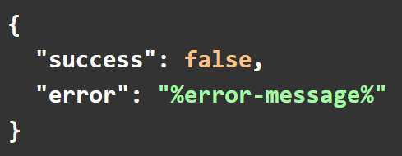
SwaggerHub API Documentation
(might restructure / reword this later)
Success Response:
API Information:
REST-style
Strictly consumes and produces JSON formatted data
All API responses follow the JSON format indicate on the right
Handles user and contact operations through SQL queries
Uses cookie-based session handling
Validates and sanitizes request parameters
HTTP Response Code:
200 - OK
Error Response:
HTTP Response Codes:
400 – Invalid Input
401 – Invalid Session / Incorrect Credentials
403 – Already Logged In
405 – Method Not Allowed
409 – Credentials Already Taken
500 – Internal Server Error

Slide 28
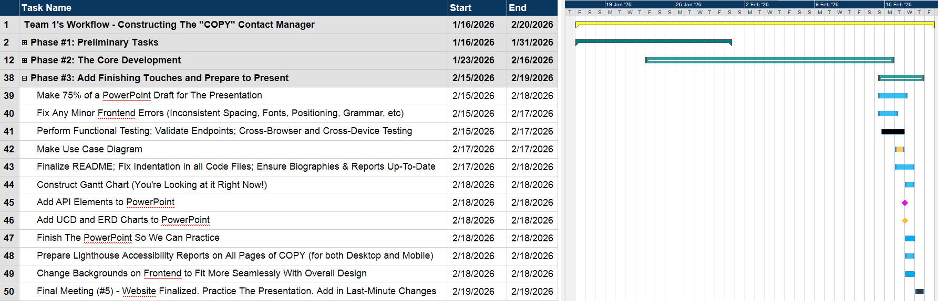
Gantt Chart - Phase #3: Add Finishing Touches to Prepare and Present
Color Key for Gantt Chart – Phase #3: Add Finishing Touches to Prepare and Present
Yellow = Overall Project Timeline
Blue = A Task Completed by Adam
Black = A Task Completed by Everyone
Orange = A Task Completed by Darren
Pink = A Task Completed by Andrew

Slide 29
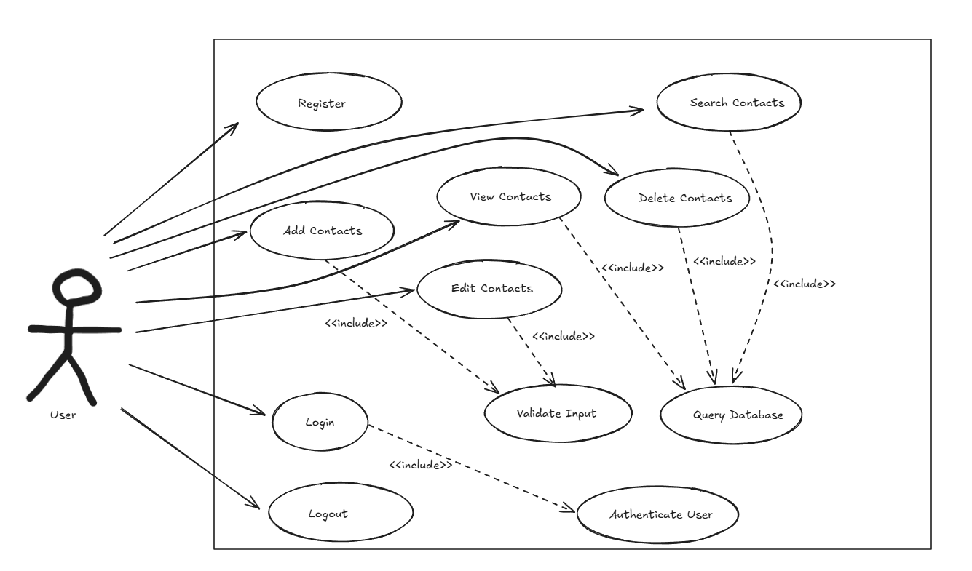
Use Case Diagram
The diagram centers around a single user actor.
All contact operations map directly to CRUD functionality.
<<include>> was used for shared processes like validation, authentication, and database queries.
This design improves modularity and reflects how the backend logic is structured.

Slide 30
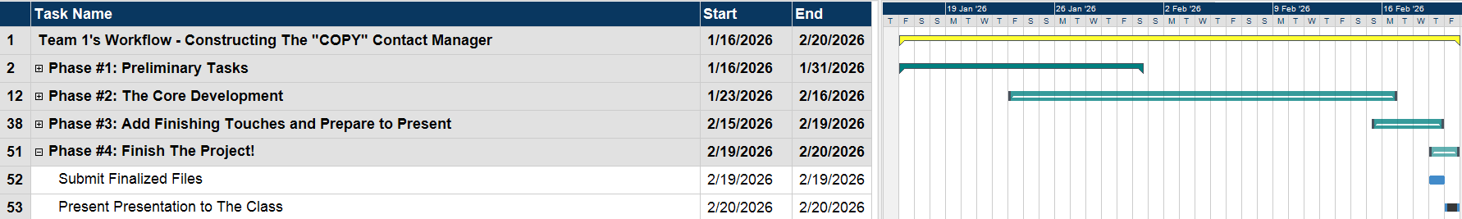
Gantt Chart - Phase #4: Finish The Project!
Color Key for Gantt Chart – Phase #4: Finish the Project!
Yellow = Overall Project Timeline
Turquoise = A Main Phase Timeline
Blue = A Task Completed by Adam
Black = A Task Completed by Everyone

Slide 31
How Did The Construction Go?

Slide 32
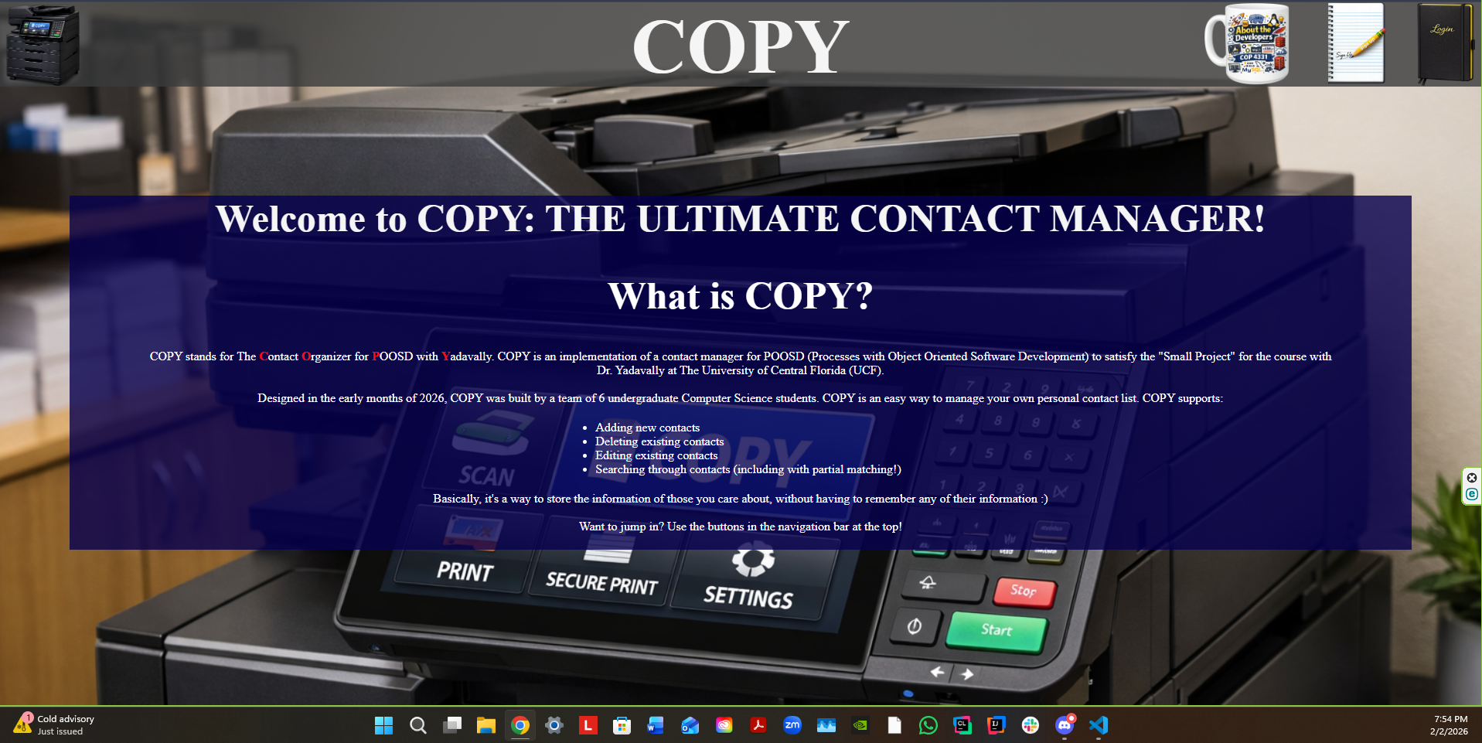
Things That Did Go Well
We got to work right away – We had the server, Git repository and domain ready to go by the beginning of week 2
We made sure to reach out to each other if we had different ideas, issues, or general concerns
We helped each other out when trying to learn something new
We ensured that we made decent progress to keep the project on schedule, while doing our best to follow the project’s requirements
We ensured that each member of the team was valued and understood

Slide 33
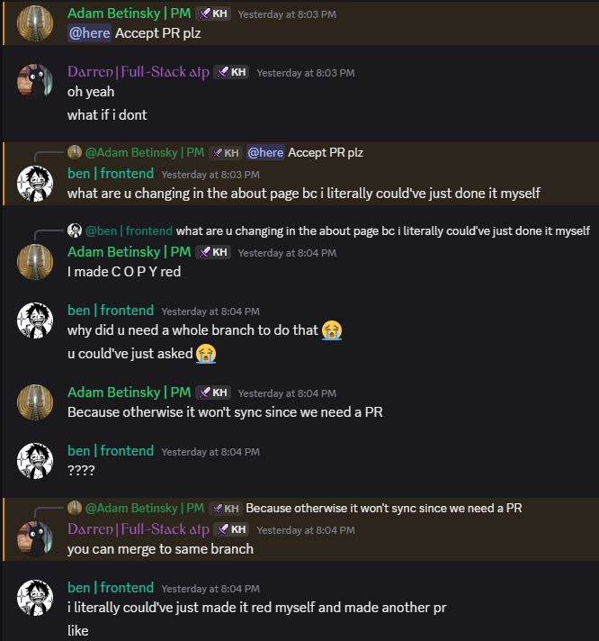
Things That Did NOT Go Well
We had conflicts from time-to-time. Whether it be about different ideas for the website design, how to organize the Git repository, or arguing over who should do a task, it was inevitable
We had a few occasions where some group members slacked a little and didn’t do their part. We would sometimes have to remind each other to get stuff done on time and/or respond to their messages
We had some miscommunication and confusion at times with the project requirements and/or implementation. For example, we didn’t realize we needed pull requests in our GitHub repository until week 5

Slide 34
Website and API Demonstrations

Slide 35
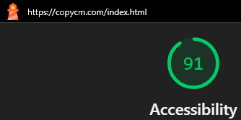
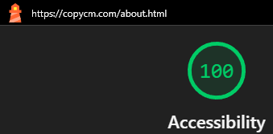
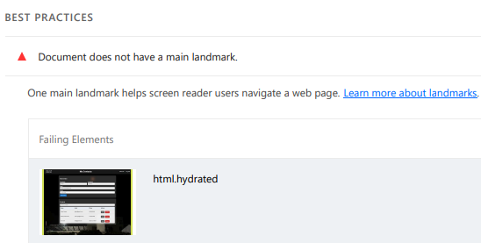
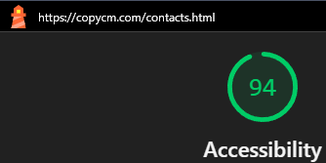

How Did We Do In Terms of Accessibility?
For all 3 of our Frontend pages, we had Lighthouse scores in the “Excellent” Range $\left(≥90\right)$. Each page’s score was 91 or higher, on both Desktop and Mobile devices This means that we tackled accessibility concerns well overall.
With that said, however, there are some areas that could be improved further if we had the time. For example, we lost some points on the score for the contacts page since we didn’t have a “main landmark”. Without this, those who rely on screen readers will likely have more difficulty using the crucial portions of the website.

Slide 36
Any Questions?

Slide 37
Outside Images Used in This Presentation
Main Background: https://www.pexels.com/photo/lines-of-code-2653362/
Discord Logo: https://www.vecteezy.com/vector-art/6892625-discord-logo-icon-editorial-vector
LettuceMeet logo: https://x.com/lettucemeetapp
Zoom Logo: https://1000logos.net/zoom-logo/
Git Logo: https://www.google.com/imgres?q=git%20logo&imgurl=https%3A%2F%2Fgit-scm.com%2Fimages%2Flogos%2Fdownloads%2FGit-Icon-1788C.png&imgrefurl=https%3A%2F%2Fgit-scm.com%2Fcommunity%2Flogos&docid=CMTH9vchny6mPM&tbnid=jpq4xLgv36ZQ1M&vet=12ahUKEwjlx6X8muKSAxWKmmoFHdFvE2QQnPAOegQIIBAB..i&w=383&h=383&hcb=2&ved=2ahUKEwjlx6X8muKSAxWKmmoFHdFvE2QQnPAOegQIIBAB
GitHub Logo: https://pixabay.com/vectors/github-github-logo-github-icon-6980894/
ChatGPT Logo: https://logovent.com/blog/chatgpt-logo-history/
MindView Logo: https://ul.gpii.net/content/mindview-7

Slide 38
Thank You!

